Slide 1
Full Stack Development
Palanisamy Thangamuthu

Slide 2
What is Full Stack?
Full stack development is the process of designing, creating, testing, and deploying a complete web application from start to finish.
Involves working with various technologies and tools, including front-end web development, back-end web development, and database development.
Responsible for the entire web application development process.
High demand because they can build a website or application from start to finish and quickly

Slide 3
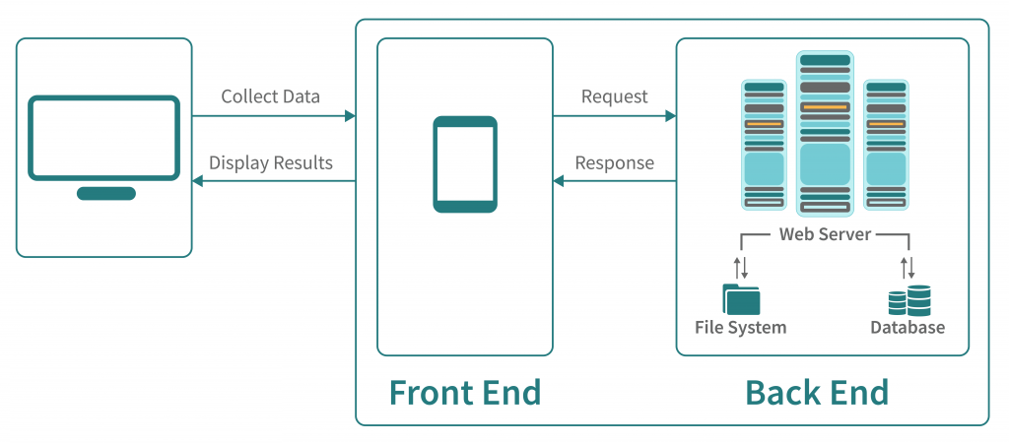
How Web Application Works?

Slide 4
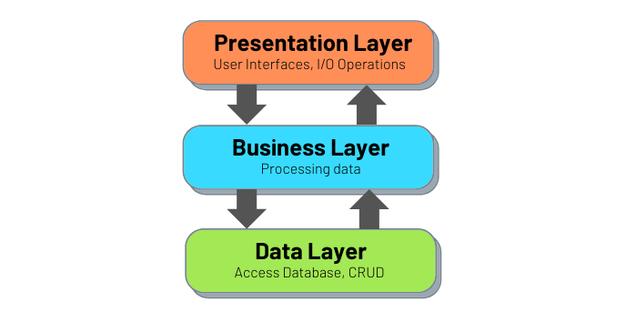
Traditional Web Development

Slide 5
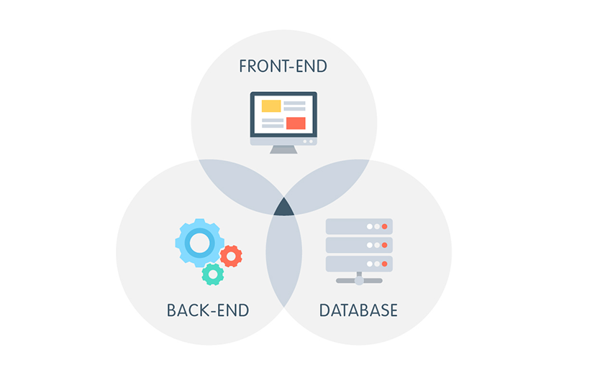
Full Stack Development

Slide 6
Frontend Technologies
HTML
CSS
Javascript Libraries such as jQuery, React, ZeptoJS
Frameworks like Angular, Vue, Backbone, Ember
Bootstrap, Tailwind, Material, PrimeNG

Slide 7
Backend Technologies
Java(Spring)
PHP(Laravel)
NodeJs(Express)
Python(Django, Flask, Pylons)
Ruby(Ruby on Rails)

Slide 8
Databases
Mysql
PostgreSQL
MongoDB
CouchDB
Oracle

Slide 9
Servers
Apache
Nginx

Slide 10
Popular Stacks
MERN Stack: MongoDB, Express, ReactJS and Node.js
MEAN Stack: MongoDB, Express, AngularJS & Node.js
Django Stack: Django, python and MySQL as Database.
Rails or Ruby on Rails: Uses Ruby, PHP and MySQL.
LAMP Stack: Linux, Apache, MySQL and PHP.

Slide 11
Frontend Technologies
HTML, CSS, Angular & Angular Material

Slide 12
HTML
HTML - What is HTML?
<html>
<head>
</head>
<body>
<div>
<p>Hi</p>
</div>
</body>
</html>
HTML means Hyper Text Markup Language.
The HTML allow us to define structure of a document.
NOT programming language, it’s a markup language.
It is a series of nested tags (it is a subset of XML) that contain all the website information like texts, images and videos.
<title>This is a title</title>
The HTML defines the page structure. A website can have several HTMLs to different pages.

Slide 13
HTML - Syntax
<div id="main">
<!-- this is a comment -->
This is text without a tag.
<button class="mini">press me</button>
<img src="me.png" />
</div>

Slide 14
HTML Attributes
Elements/Tags
Attributes
Values
Comments
Text Tag
Self-closing Tag

Slide 15
HTML Tags
Headings - <h1> to <h6>
Paragraphs - <p>
Links - <a>
Images - <img>
Buttons - <button>
Lists, Tables, Audio, Video,....

Slide 16
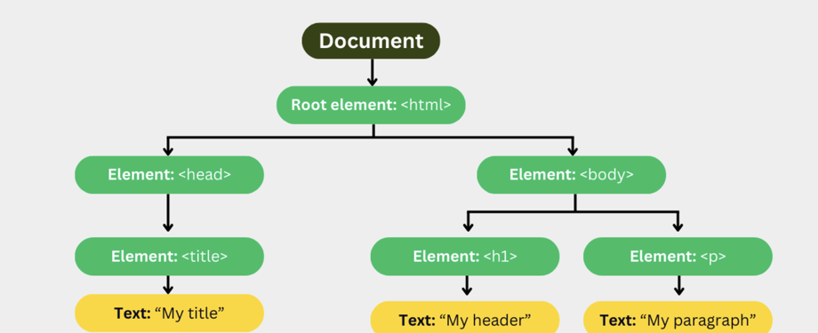
DOM Structure

Slide 17
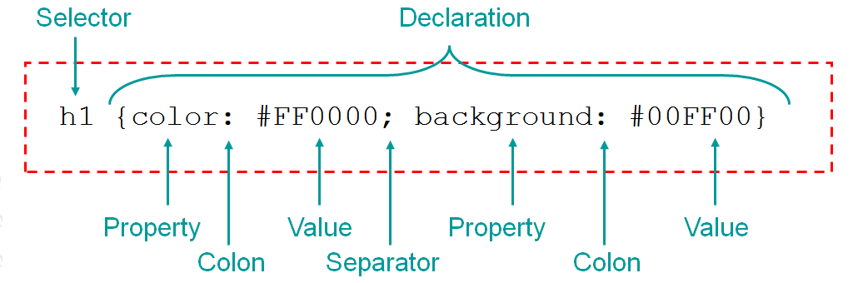
HTML
CSS - What is CSS?
CSS stands for Cascading Style Sheets
CSS describes how HTML elements are to be displayed

Slide 18
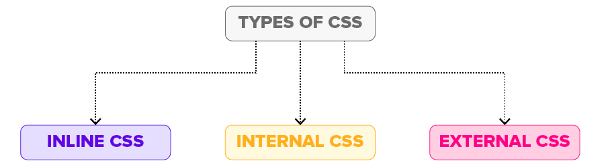
HTML
CSS - Types of Stylesheets

Slide 19
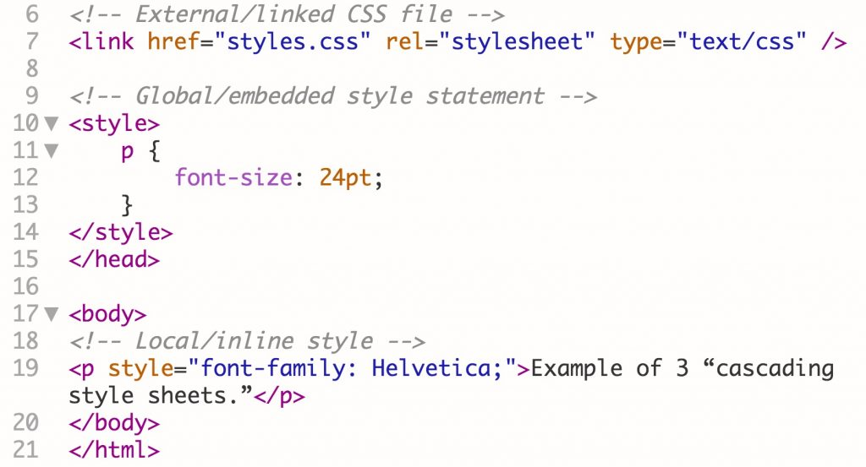
HTML
CSS - Types of Stylesheets

Slide 20
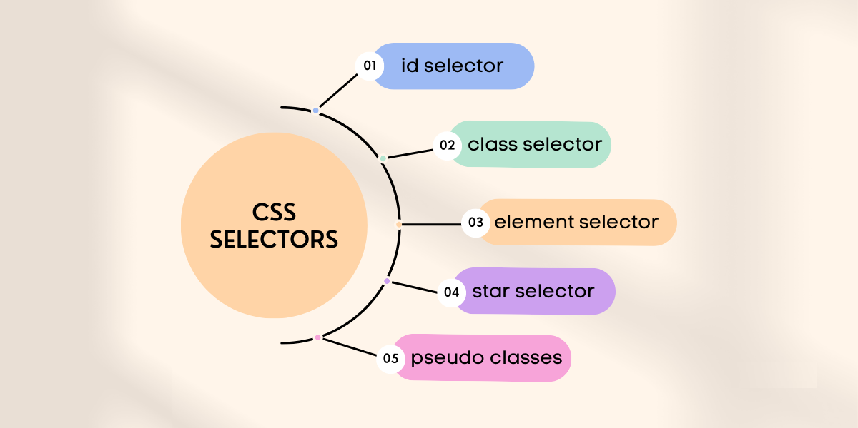
CSS Selectors

Slide 21
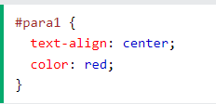
Id selector
The id selector uses the id attribute of an HTML element to select a specific element.
The id of an element is unique within a page, so the id selector is used to select one unique element!
To select an element with a specific id, write a hash (#) character, followed by the id of the element.

Slide 22
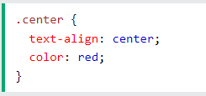
Class selector
The class selector selects HTML elements with a specific class attribute.
To select elements with a specific class, write a period (.) character, followed by the class name.

Slide 23
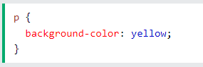
Element selector
The element selector selects all elements with the specified element name.

Slide 24
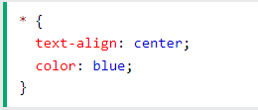
The CSS Universal Selector(Start Selector)
The universal selector (*) selects all HTML elements on the page.

Slide 25
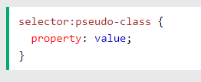
CSS Pseudo-classes
A pseudo-class is used to define a special state of an element.
For example, it can be used to:
Style an element when a user mouses over it
Style visited and unvisited links differently
Style an element when it gets focus

Slide 26
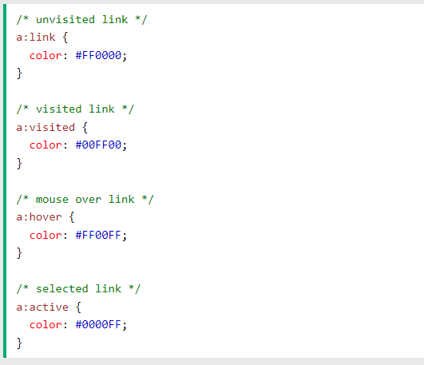
CSS Pseudo-classes - Example

Slide 27
Angular Material - What is Angular Material?
A UI component library for Angular
Provides high-quality UI components that follow Material Design principles
Helps developers create beautiful, responsive, and modern web applications
Ensures consistent look and feel across devices

Slide 28
Why Use Angular Material?
Pre-built Components - Ready-to-use UI components like buttons, cards, forms, navigation, etc
Responsive Layouts - Built-in flexibility for creating mobile-first, responsive designs
Material Design Principles - Ensures modern, consistent UI designs that follow Google’s Material Design guidelines
Accessibility - Components are accessible by default, making apps more inclusive

Slide 29
Key Features
Component Library - Buttons, Forms, Dialogs, Inputs, Toolbars, Tables, etc
Theming - Customizable color schemes, typography, and styles
Responsive Layout - Grid system and Flex Layout integration
Animations - Built-in animations for smooth user experience

Slide 30
Getting Started with Angular Material
https://material.angular.io/guide/getting-started

Slide 31
What is JavaScript?
JavaScript, often abbreviated JS, is a programming language that is one of the core technologies of the World Wide Web.
Creating sliders, alerts, click interactions, pop ups, etc on the websites
Server side script non-browser environments Node.js
Electron for writing desktop applications
React Native for mobile applications

Slide 32
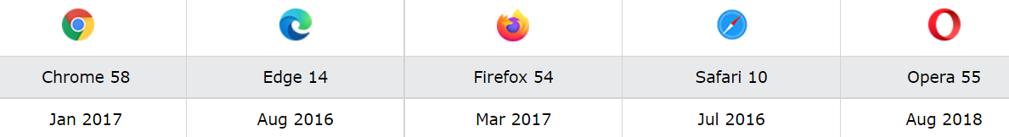
Javascript ES6
ECMAScript 2015 was the second major revision to JavaScript
ECMAScript 2015 is also known as ES6 and ECMAScript 6
Supported browsers

Slide 33
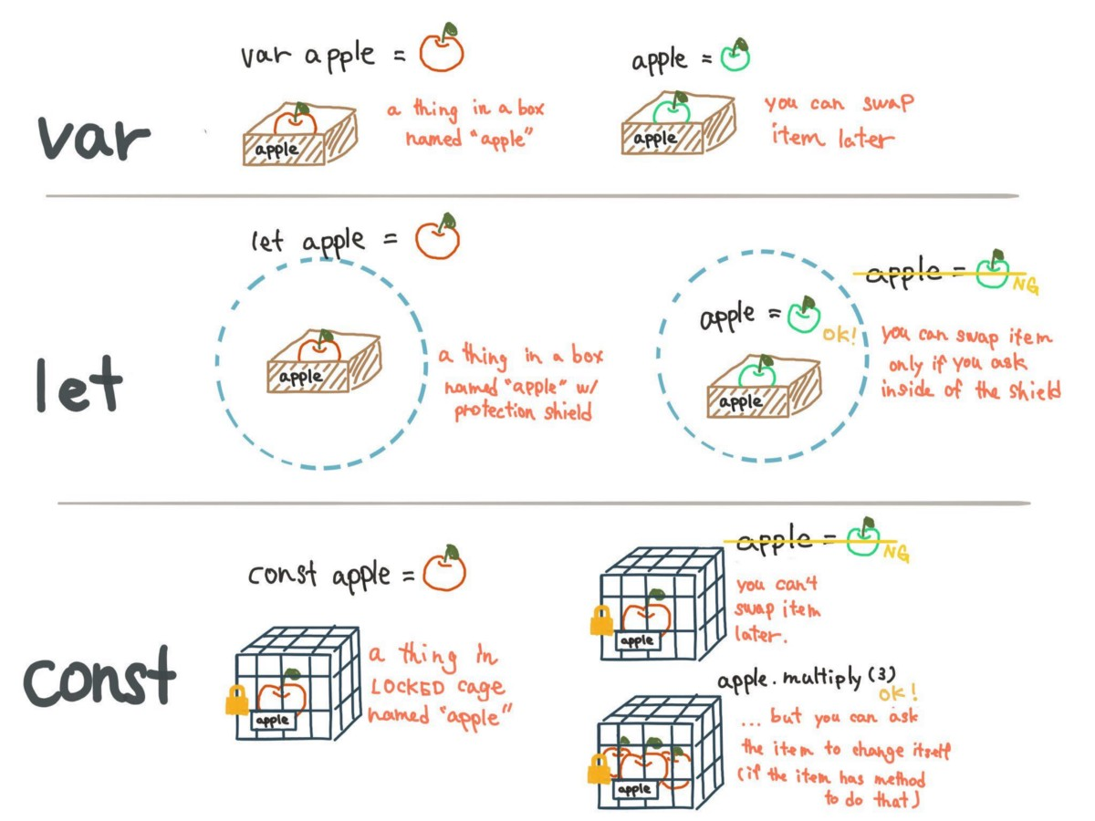
Let and Const

Slide 34
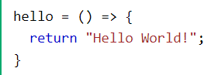
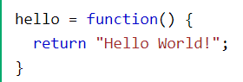
Arrow Function
Introduced in ES6.
To write shorter function syntax.

Slide 35
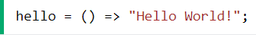
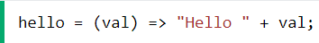
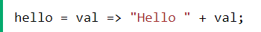
Arrow Function
Function has only one statement, and the statement returns a value.
Remove the brackets and the return keyword

Slide 36
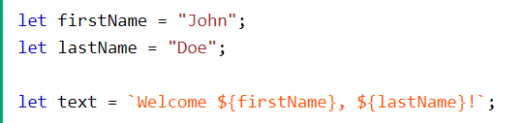
Template Literals
Template Literals use back-ticks (``) rather than the quotes ("") to define a string
No need to use the plus (+) operator to concatenate strings

Slide 37
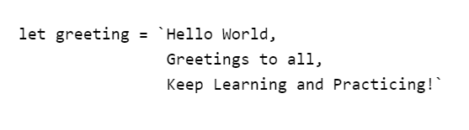
Multi-line Strings
Create multi-line strings by using back-ticks(`)

Slide 38
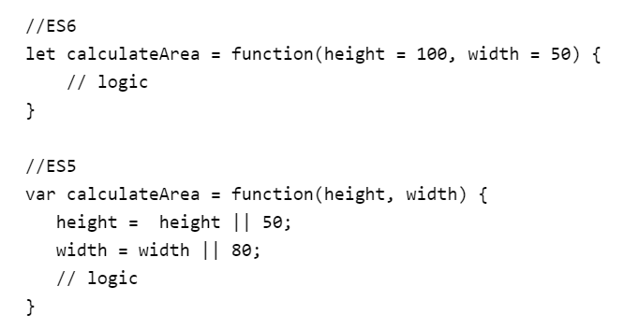
Default Parameters
Users can provide the default values right in the signature of the functions. But, in ES5, OR operator had to be used.

Slide 39
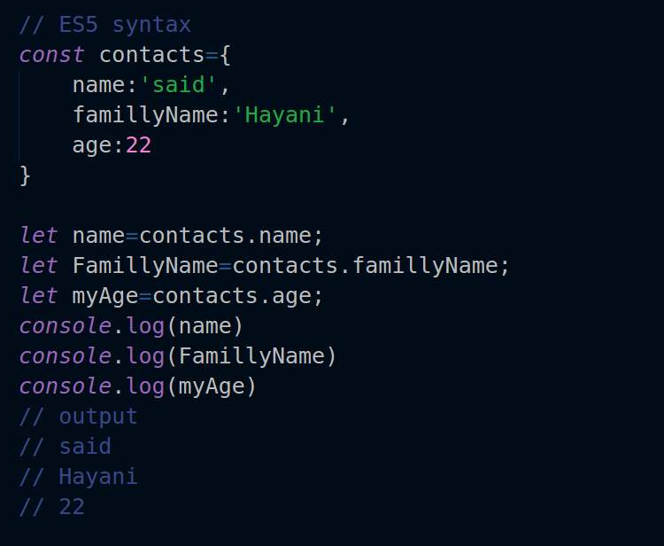
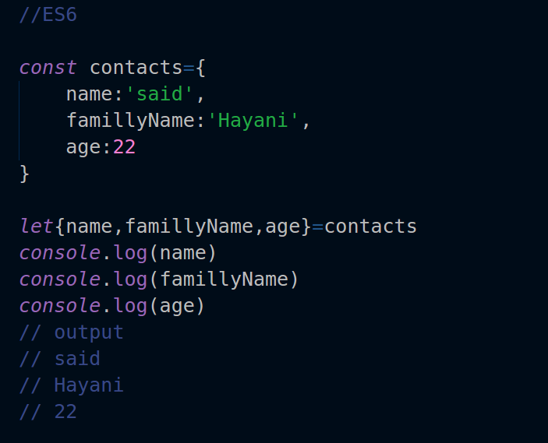
Array and object destructing
Destruction makes the assignment of the values of an array or object to the new variable easier.

Slide 40
Classes
Classes are introduced in ES6 which looks similar to classes in other object-oriented languages, such as C++, Java, PHP, etc.

Slide 41
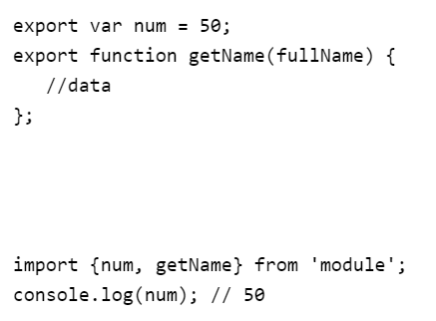
Modules
Each module is represented by a separate ".js" file.
We can use the "import" or "export" statement in a module to import or export variables, functions, classes or any other component from/to different files and modules.

Slide 42
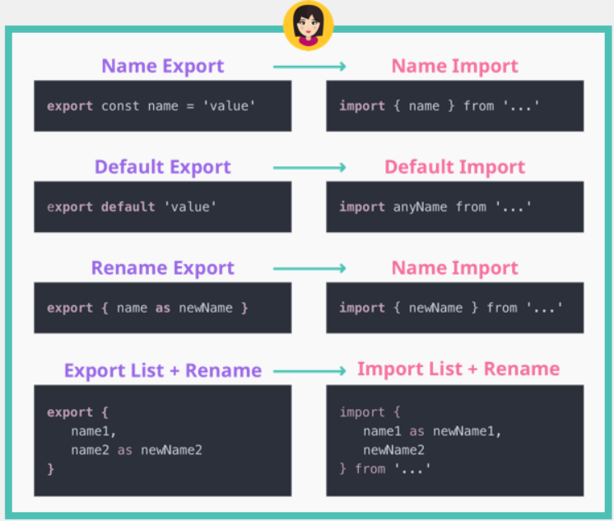
Modules

Slide 43
What is Angular?
Angular is an open-source front-end web application framework
Allows developers to create dynamic web applications that are more interactive and responsive.
Developed by Google
It is a framework not a library

Slide 44
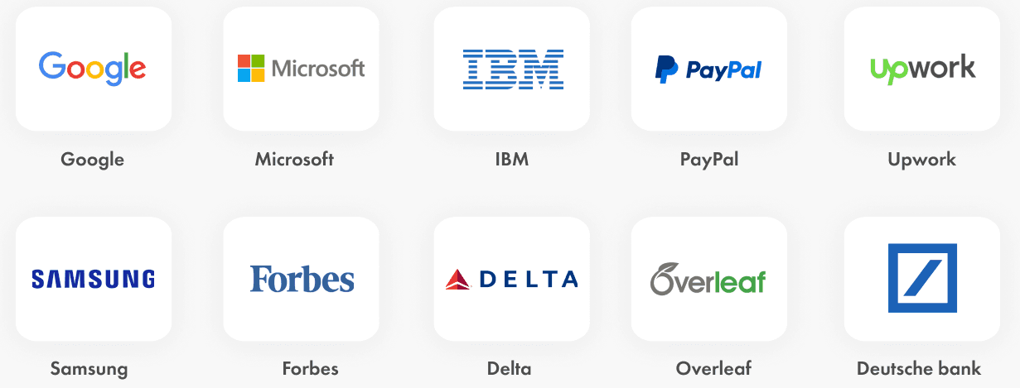
Who uses Angular?

Slide 45
Angular History
Miško Hevery and Adam Abrons created AngularJS in 2009.
Created AngularJS as a side project to make it easier to develop web applications for internal projects.
The original purpose was to provide software for an online JSON storage service
Google later took over the project and built a team to maintain it

Slide 46
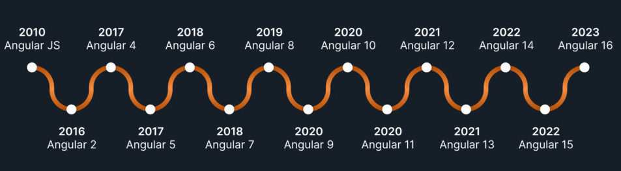
Angular History
Angular, introduced in 2016, is a complete rewrite using TypeScript
Latest Angular version 19, which was released in November 2024

Slide 47
Getting Started with Angular

Slide 48
Setting Up the Development Environment
Install Node.js and npm
Install Angular CLI (Command Line Interface)
Create your first Angular project using Angular CLI
Running the Angular application for the first time

Slide 49
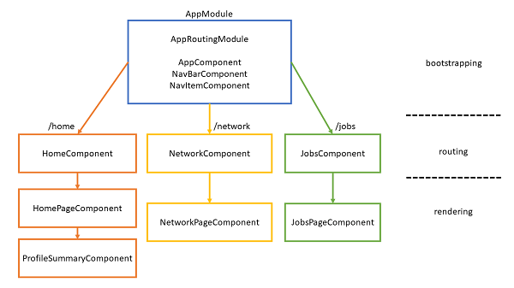
Angular Fundamentals - Application Structure

Slide 50
Angular Fundamentals - Component
Components are self-contained reusable building blocks of web application.
Angular components are basically just idempotent functions (same input produces same output).
They describe your UI at any point in time, just like a server-rendered app.

Slide 51
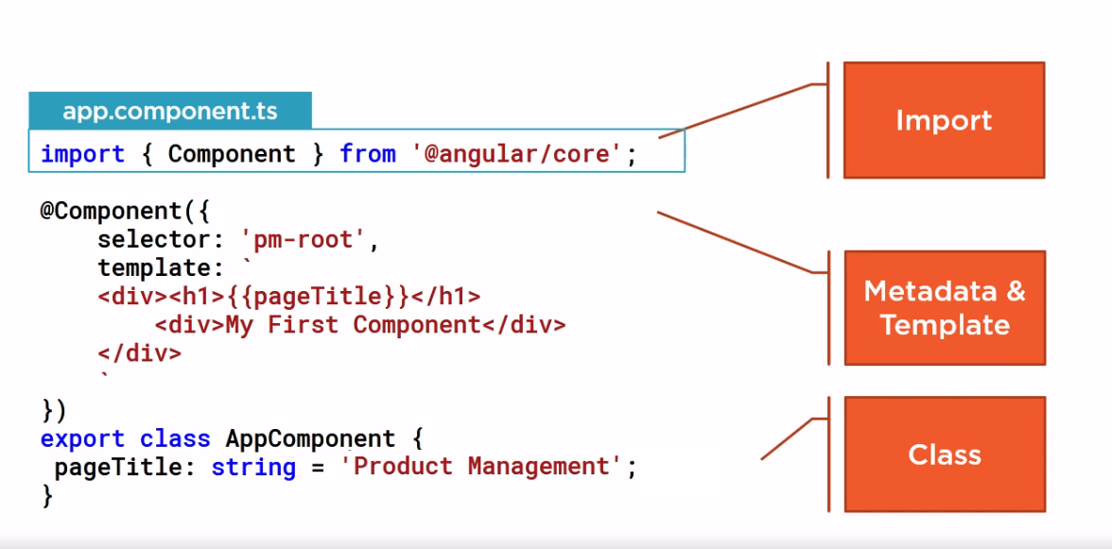
Angular Component

Slide 52
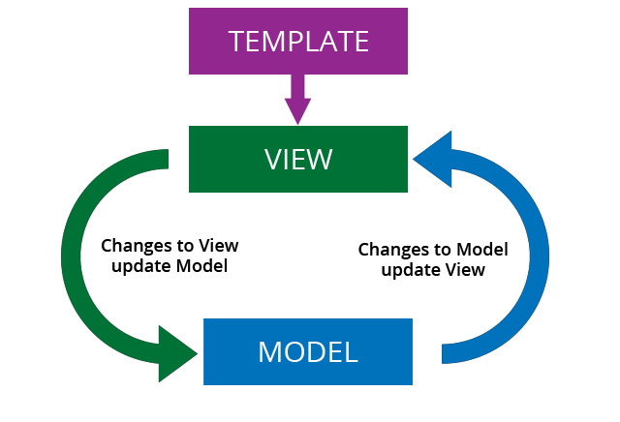
Angular Fundamentals - 2 Way Binding

Slide 53
Angular Events
Just like HTML DOM events, Angular can perform actions based on user events.
Using parentheses () to bind events to component methods.
Basic syntax of event binding: (click), (change), (input), etc.
Event binding for common input events (e.g., keyup, keydown, input).

Slide 54
Angular Routing
Introduction to Angular Router.
Setting up routes for different views.
Navigation between views using routerLink.
Nested Routes
Lazy Loading

Slide 55
Angular Directives
Directives are special markers in the DOM (HTML) that allow you to attach behavior to elements, attributes, and classes.
Directives enhance the HTML templates and give them more power by adding dynamic behavior.
Separation of concerns: Directives focus on building reusable behaviors
Types of Angular Directives
Structural
Attribute

Slide 56
Working with Angular Forms
Template-driven forms vs. Reactive forms.
Validating form input.
Submitting form data.
Nested Forms
Dynamic Forms

Slide 57
Services and Dependency Injection
What is a service in Angular?
Creating and using services
Injecting services into components using Angular's DI system
Built-in services
Examples

Slide 58
Handling HTTP Requests
What is HTTP Request?
Making API requests with the HttpClient module
Fetching data from a REST API
Handling Responses
Handling Errors

Slide 59
Testing Your Angular Application
What is Unit Testing?
Introduction to unit testing in Angular
Using Jasmine and Karma to run tests
Testing components and services
Coverage Report

Slide 60
CRUD Operations
Create
Read
Update
Delete

Slide 61
Database
MongoDB

Slide 62
What is a database
A database is a structured, organized set of data.
Common examples of databases:
Telephone book
Student records
Database management systems are computer software applications that interact with user, other apps, and the db itself to capture and analyze data.
Well-known DBMSs include MYSQL, PostgreSQL, Oracle and IBM DB2

Slide 63
MongoDB - What is MongoDB
Scalable High-Performance Open-Source, Document-oriented database.
Built for Speed.
Rich document based queries for Easy readability.
Full index support for High Performance.
Replication and Failover for High Availability.
Map/Reduce for Aggregation.

Slide 64
Why to use MongoDB?
SQL was invented in the 70’s to store data.
MongoDB stores documents or objects.
Nowadays everyone works with objects(Python/Node/Java…)
We need db to store objects, why not store them directly?
Embedded docs & arrays reduce needs for joins.

Slide 65
What is MongoDB great for?
RDBMS replacement for web applications.
Semi-structured content management systems.
Real-time analytics and High-speed logging.
Caching and High scalability.
Web 2.0, Media, SAAS, Gaming, Healthcare, Telecom, Government,....

Slide 66
Not great for?
Highly transactional applications.
MongoDB requires more storage than other well-known databases.
It doesn't automatically clean up its disk space, so it must be done manually.
It isn't easy to join two documents in MongoDB.
Their document is restricted in size to 16 MB.
Document nesting at a depth of more than 100 layers is not allowed.

Slide 67

Who is using MongoDB?

Slide 68
Database = Database
Made up of multiple collections.
Created on-the-fly when referenced for the first time.

Slide 69
Collection = Table
Schema-less, and contains documents.
Indexable by one or more keys.
Created on-the-fly when referenced for the first time.
Capped Collections: Fixed size, older records get dropped after reaching the limit.

Slide 70
Document = Record
Stored in a collection.
Can have _id key - works like primary keys in mySQL
Supported relationships.
Document storage in BSON(Binary form of JSON) format.

Slide 71
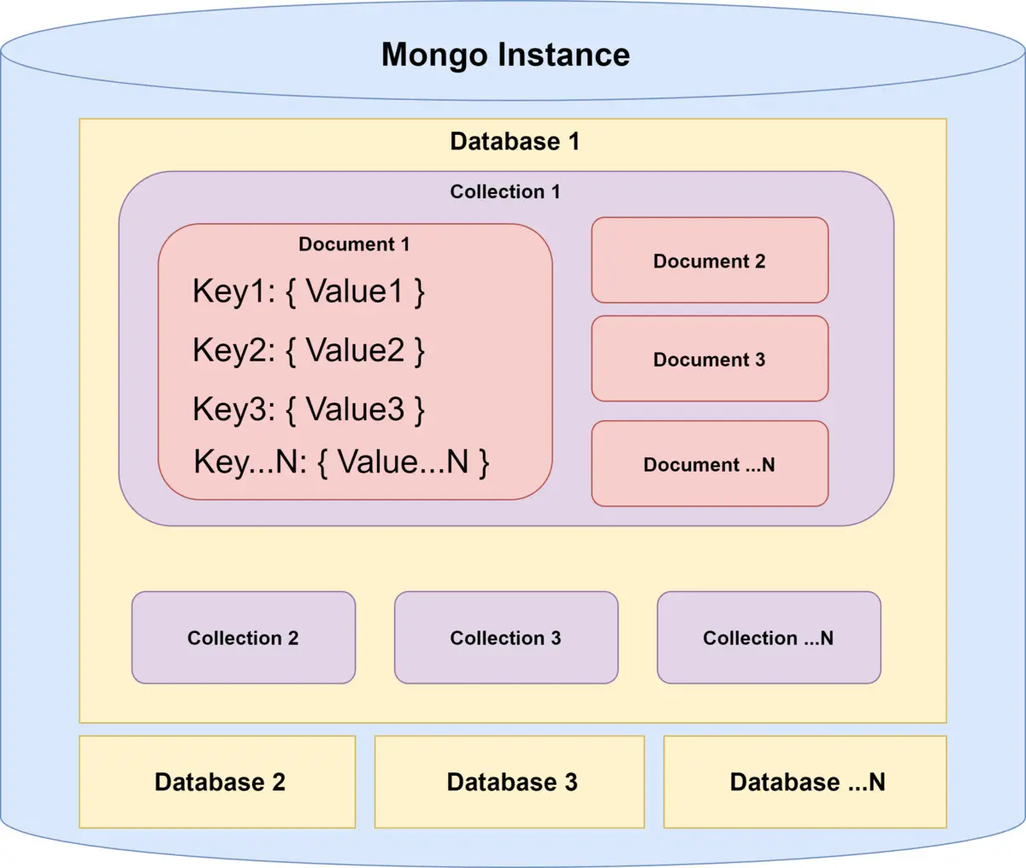
Database - How it look likes?

Slide 72
Backend
NodeJs & Express

Slide 73
What is NodeJS?
In simple words it is “Server side Javascript”.
V8 is open-source Javascript engine developed by Google. Its written using C++ and used in chrome browser.
Node.js runs on V8.
Its open-source runs on Linux, Windows and other OS as well.
High performance network applications framework, well optimized for concurrent environments.

Slide 74
What is NodeJS?
It’s a command line tool.
Its written in 40% Js and 60% C++.
It uses an event-driven, non-blocking I/O model, which makes it lightweight.
It makes use of event-loops via Javascript’s callback functionality to implement non blocking I/O.
Programs in node.js are written in Javascript but not the same. There will be no DOM implementation provided in Node.js
Everything in node.js runs in a single-thread.

Slide 75
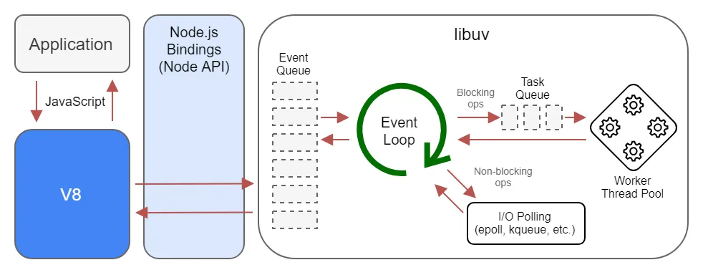
NodeJS - Event Loops

Slide 76
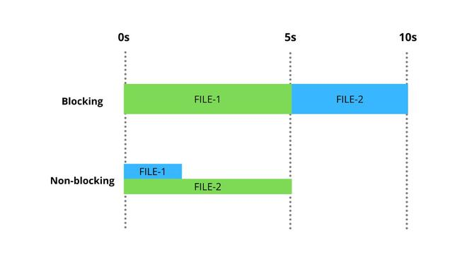
NodeJS - Non-blocking

Slide 77
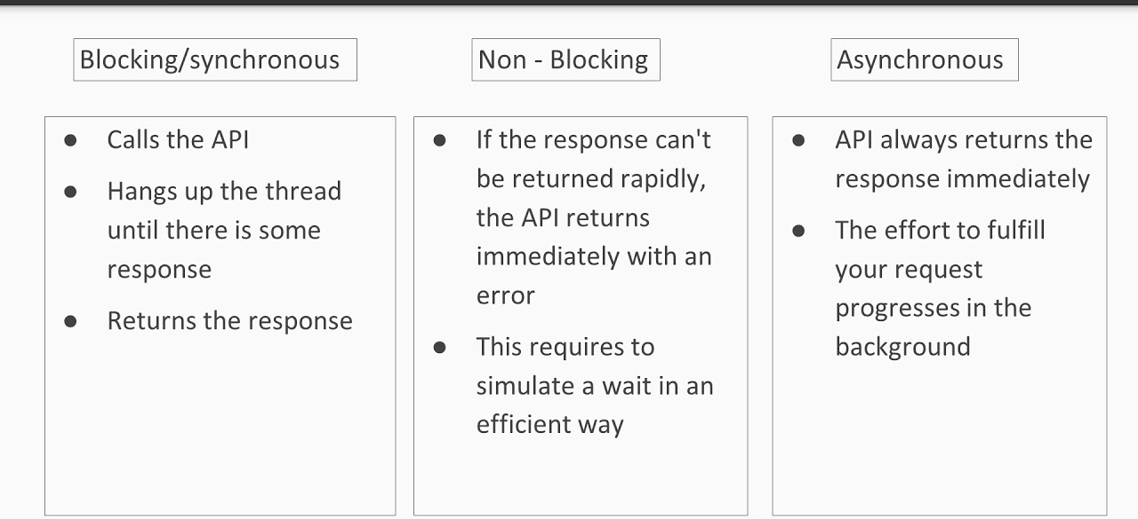
Blocking & Non-blocking Difference

Slide 78
What can you do with NodeJS
You can create HTTP Server
Can create TCP Server in just 4 lines of code
You can create DNS Server
You can create Static File Server
You can create Web Chat Application in browser
Can also be used to create online games, collaboration tools or sends updates to the user in real-time.

Slide 79
NodeJS Ecosystem
NodeJS heavily relies on modules
Creating a module is very easy, just put your js code in a separate file and include it in your code using import.
Libraries in NodeJs are called as packages and they can be installed using “npm install packagename”
NPM(Node Package Manager) comes bundled with node.js installation.

Slide 80
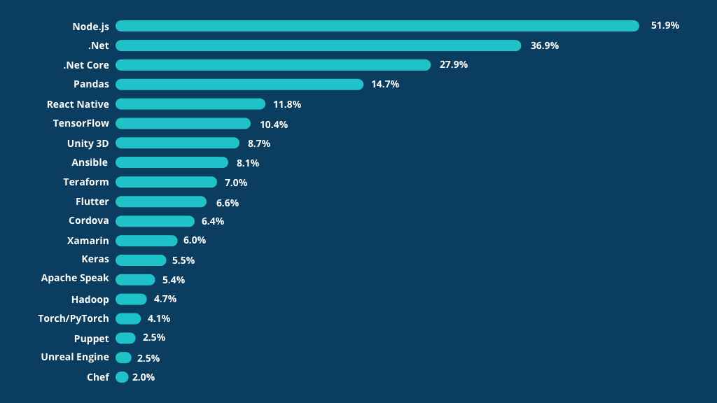
NodeJS Benchmarks

Slide 81
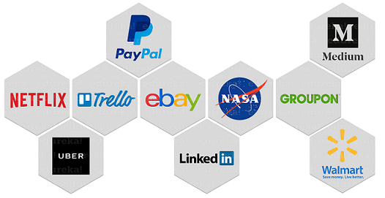
Who is using NodeJS

Slide 82
Disadvantages of NodeJS
When doing heavy and CPU intensive calc - event-loops are CPU hungry
NPM Dependency Nightmare
It has tons of nested callbacks
It has an unstable API
It has high demand but few experienced developers

Slide 83
What is Express Js?
Minimalist web application framework
Runs on NodeJS.
It is used to build a single page, multipage, and hybrid web application.
It's a layer built on the top of the Node js that helps manage servers and routes.

Slide 84
Express - REST API Overview
Method | URLs | Action
GET | /users | Get all users
GET | /users/:id | Get the user by id
POST | /users | Add a new user
PUT | /users/:id | Update the user by id
PATCH | /users/:id | Update the user properties by id
DELETE | /users/:id | Remove the user by id

Slide 85
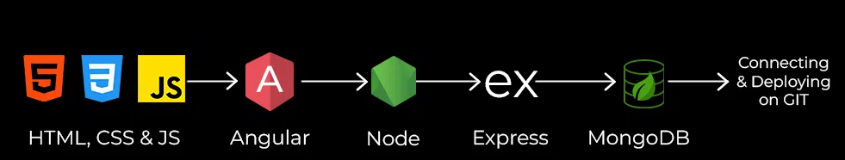
FSE - Roadmap

Slide 86
Thank You!!
9952175204
palaniscript@gmail.com
https://www.linkedin.com/in/tpalanii/

